Slide 1
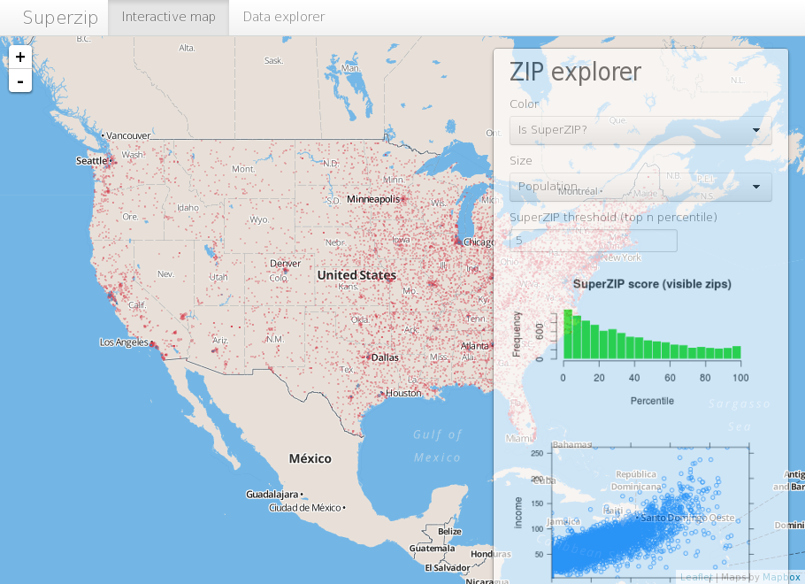
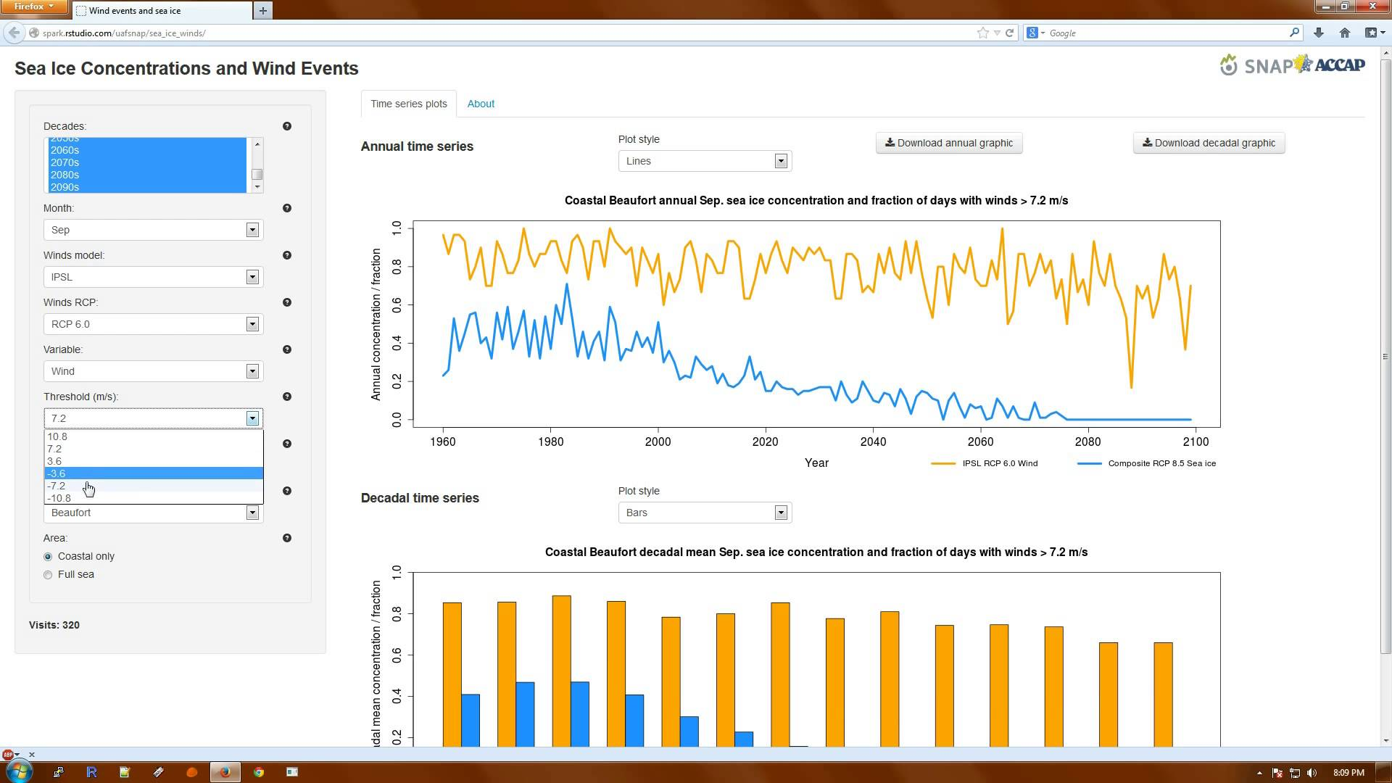
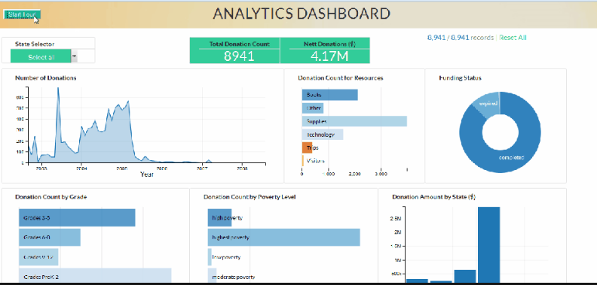
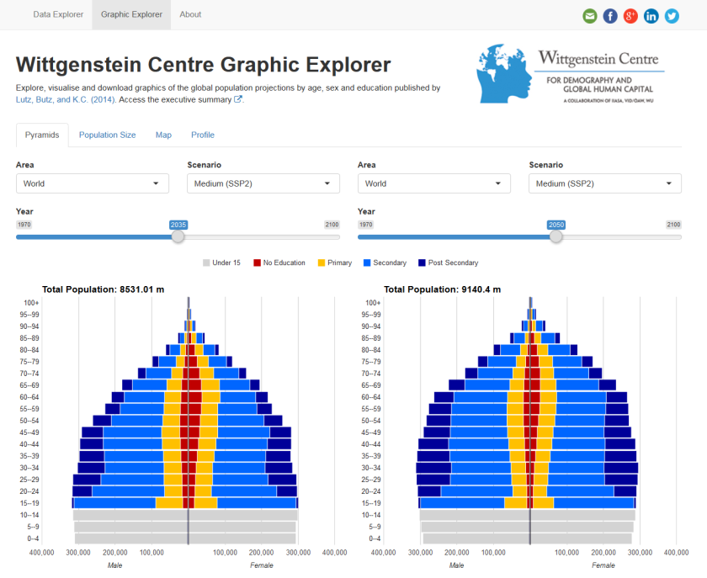
Shiny Apps Build Interactive Web Applications With R
Prepared by
Aep Hidayatuloh
aef.stk@gmail.com

Slide 2

Welcome to Shiny
Shiny is an R package that makes it easy to build interactive web applications (apps) straight from R.
The default styling of a Shiny application is clean and effective.
Very extensible and it is easy to integrate Shiny applications with your own web content using HTML and CSS.
JavaScript and jQuery can also be used to further extend the scope of Shiny applications.

Slide 3
Requirement
Tools
Latest version of R or Microsoft R Open (64-bit only)
Latest version of RStudio and shiny package
Browser (Mozilla Firefox, Google Chrome etc.)
Knowledge
R programming
Basic web knowledges

Slide 4
Lets Get Started!
Install R/Microsoft R Open and RStudio
R : https://cran.r-project.org/
MRO : https://mran.microsoft.com/open
RStudio : https://www.rstudio.com/products/rstudio/download/
Install shiny package
install.packages("shiny")

Slide 5
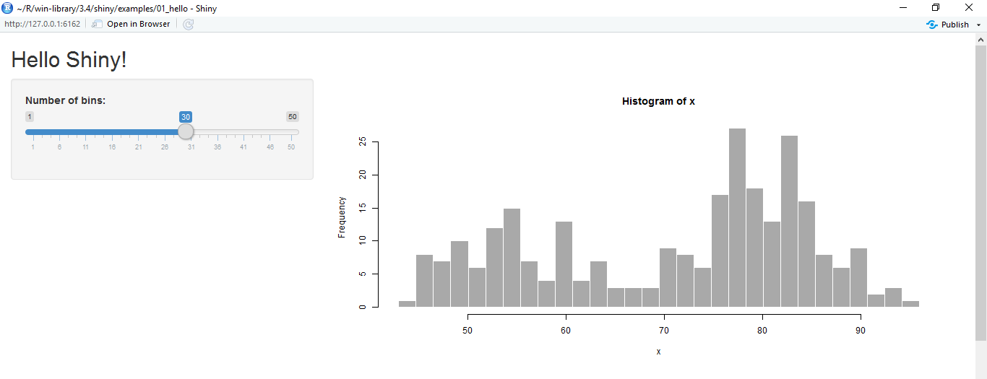
Hello Shiny!
library(shiny)
runExample("01_hello")

Slide 6
Basic Shiny Apps
Layout
Title/Header Panel
Sidebar/Input Panel
Main/Output Panel
You can create shiny apps with single file app.R or two files ui.R and server.R
ui.R
server.R
User Interface
Computation Processes

Slide 7
Know ui.R and server.R
ui.R
server.R
User Interface
Control the layout, appearance, widget for user inputs and display the output.
Eg. the title, page layout, text input, radio button, dropdown menu, graphics output etc.
Server
Set of instructions that uses the input provided by user, process them and produces the required output which is further displayed by ui.R

Slide 8
Build Our First Apps

Slide 9
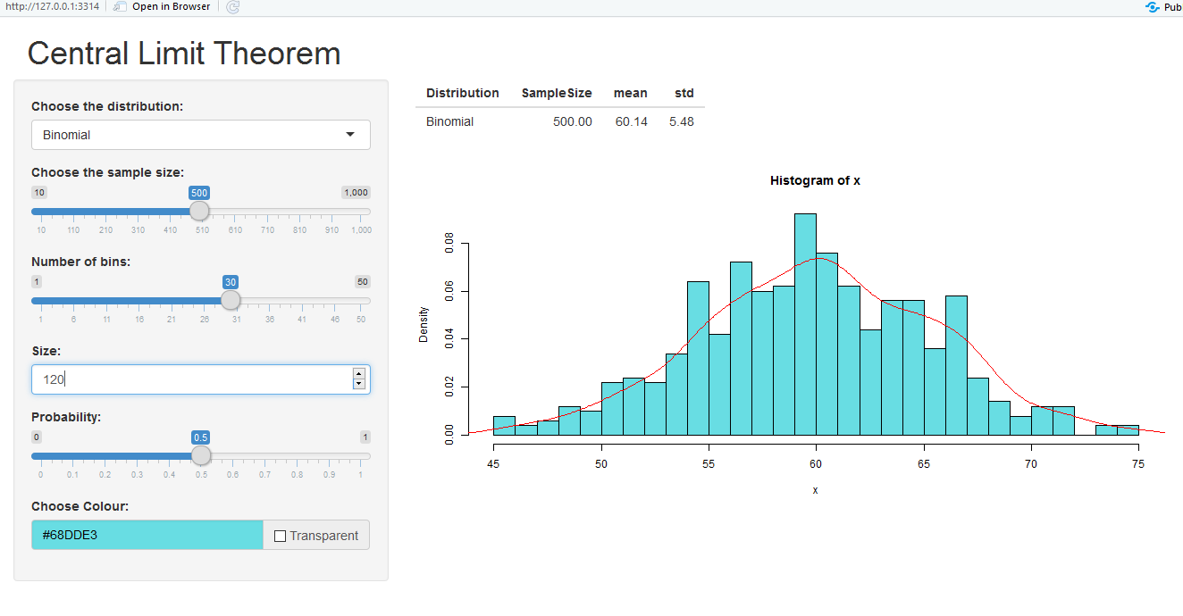
Simulate Central Limit Theorem
Create an app to simulate the Central Limit Theorem (CLT) with
3 distributions:
Uniform,
Binomial and
Normal Distribution
We will also use colourpicker package to create colour picker widget.
Use install.packages("colourpicker")
The full code is available on https://github.com/aephidayatuloh/cltheorem

Slide 10
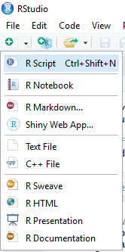
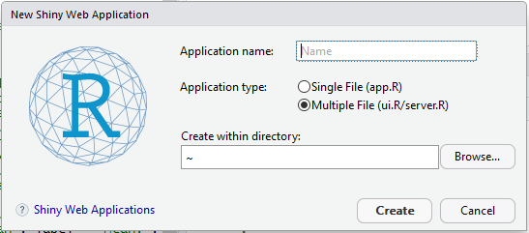
Build App
Create shiny apps template from RStudio
Provide Application name
Choose Multiple File(ui.R/server.R) for Application Type
Select folder for created shiny apps

Slide 11
Basic Shiny App Code
ui.R
server.R
library(shiny)
library(colourpicker)
shinyUI(
fluidPage(
headerPanel("Central Limit Theorem"),
sidebarLayout(
sidebarPanel("Input Panel"),
mainPanel("Output Panel")
)
)
)
library(shiny)
library(colourpicker)
shinyServer(function(input, output){
})

Slide 12
Design the User Interface
sidebarPanel(
selectInput(inputId = "dist", label = "Choose Distribution",
choices = c("Uniform", "Binomial", "Normal")),
sliderInput(inputId = "n", label = "Choose Sample Size:",
value = 30, min = 10, max = 1000, step = 10),
sliderInput(inputId = "bins", label = "Number of bins:", min = 1, max = 50, value = 30),
conditionalPanel(condition = "input.distribution == 'Uniform'",
numericInput(inputId = "min", "Minimum:", value = 0, min = 0, max = 1000),
numericInput(inputId = "max", "Maximum:", value = 1, min = 0, max = 1000)),
conditionalPanel(condition = "input.distribution == 'Binomial'",
numericInput(inputId = "size", label = "Size:", min = 0, max = 1000, value = 1, step = 1),
sliderInput(inputId = "p", label = "Probability:", value = 0.5, min = 0, max = 1)),
conditionalPanel(condition = "input.distribution == 'Normal'",
numericInput(inputId = "mean", label = "Mean:", value = 0, min = 0, max = 10, step = 0.5),
numericInput(inputId = "sd", label = "Standard Deviation:", value = 1, min = 0, max = 10, step = 0.1)),
colourInput(inputId = "cols", label = "Choose Colour:", value = "white", allowTransparent = TRUE)
),

Slide 13
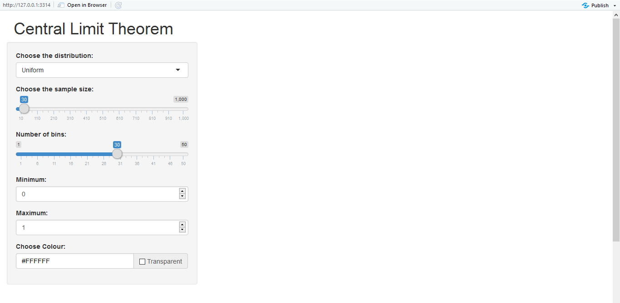
Design the Output Panel
sidebarPanel(
...
#input widget code
...
),
mainPanel(
tableOutput("summaries"),
plotOutput("myplot")
)
Run the app by click

Slide 14
Create the Brain
All processes are done in server.R.
First, we have to generate random data based on the "distribution", "sample size" and the "parameters".
All generated objects (data.frame, vector, table, plot, text, UI etc.) based on input should be created in reactive function (reactive, render*, observe etc.).

Slide 15
Create the Brain
shinyServer(function(input, output, session){
d <- reactive({
x <- switch(input$distribution,
"Uniform" = runif(n = input$n, min = input$min, max = input$max),
"Binomial" = rbinom(n = input$n, size = input$size, prob = input$p),
"Normal" = rnorm(n = input$n, mean = input$mean, sd = input$sd)
)
return(x)
})
output$summaries <- renderTable({
x <- d()
Distribution <- input$distribution
SampleSize <- input$n
data.frame(Distribution, SampleSize, mean = mean(x), std = sd(x))
})

Slide 16
Create the Brain
output$myplot <- renderPlot({
x <- d()
bins <- seq(min(x), max(x), length.out = input$bins + 1)
hist(x, breaks = bins, freq = F, col = input$cols)
lines(density(x), col="red", lwd=1) # add a density
})
})

Slide 17
Launch The App

Slide 18
Deploy Shiny Apps
You can distribute your apps for others to run on their own computers - they can download and run Shiny apps with a single R command.
This requires that they have R and Shiny installed on their computers.
There are two ways to deploy the apps, locally and on the web.
Locally → you can run the apps on your own local machine (local server) or local area network (no need internet access). You already launch the apps after you run the apps.
Web → deploy your apps to the web hosting. Shinyapps.io is free!

Slide 19
Deploy Your Apps To Web
If you want your Shiny app to be accessible over the web, so that users only need a web browser and internet access.
Shinyapps.io is a platform as a service (PaaS) for hosting Shiny web apps.
Before you get started with shinyapps.io, you will need the latest version of the rsconnect R package,
install.packages("rsconnect")
and Create a shinyapps.io account.

Slide 20
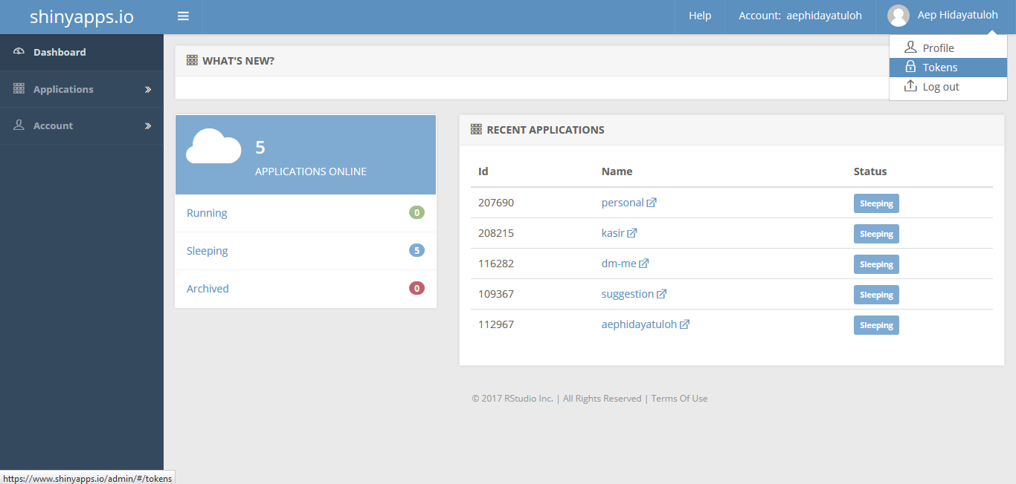
Create shinyapps.io Account
Go to https://www.shinyapps.io and create a new account by sign up or log in if you already have.
Generate token and copy

Slide 21
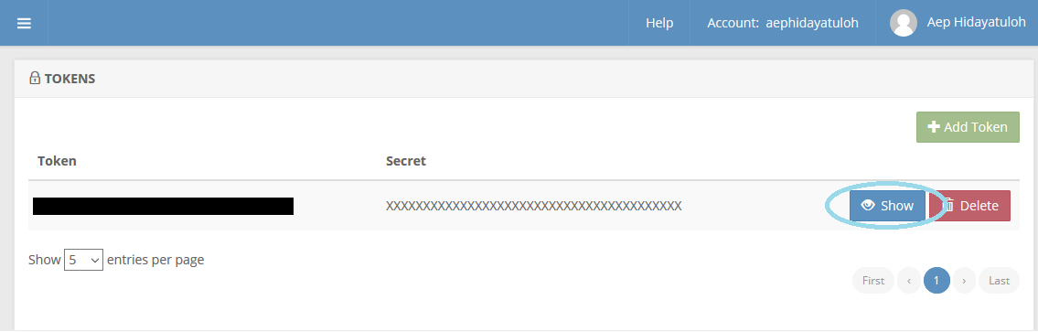
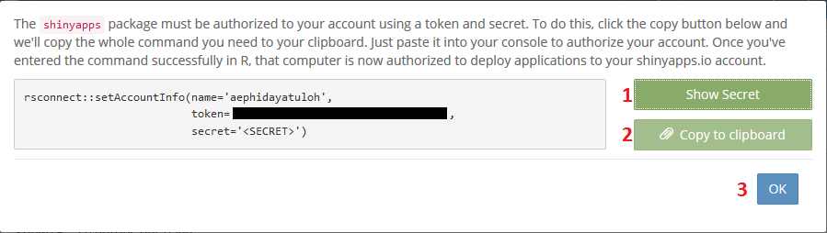
Generate Token

Slide 22
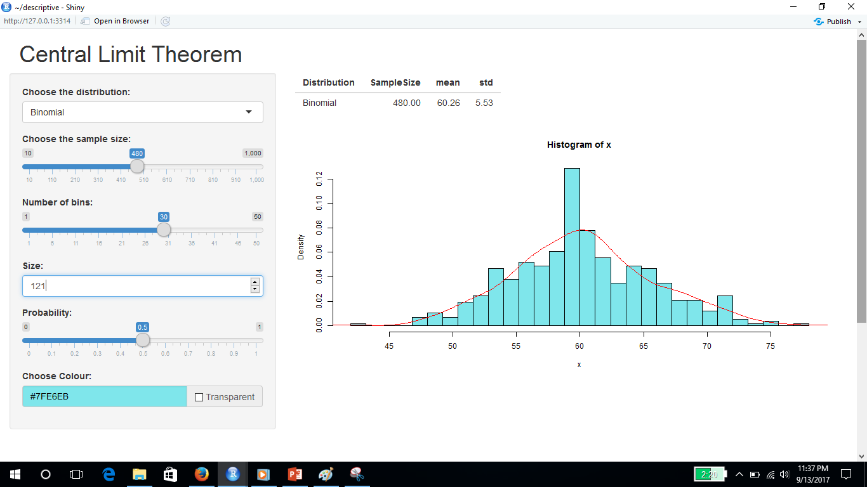

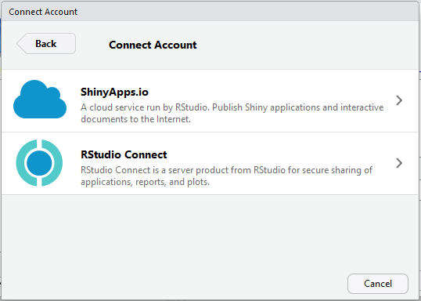
Publish Apps

Slide 23
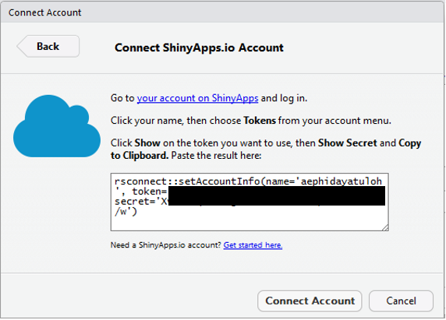
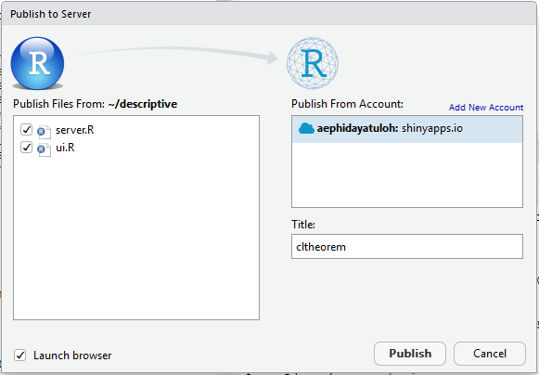
Setting Connection
https://aephidayatuloh.shinyapps.io/cltheorem

Slide 24
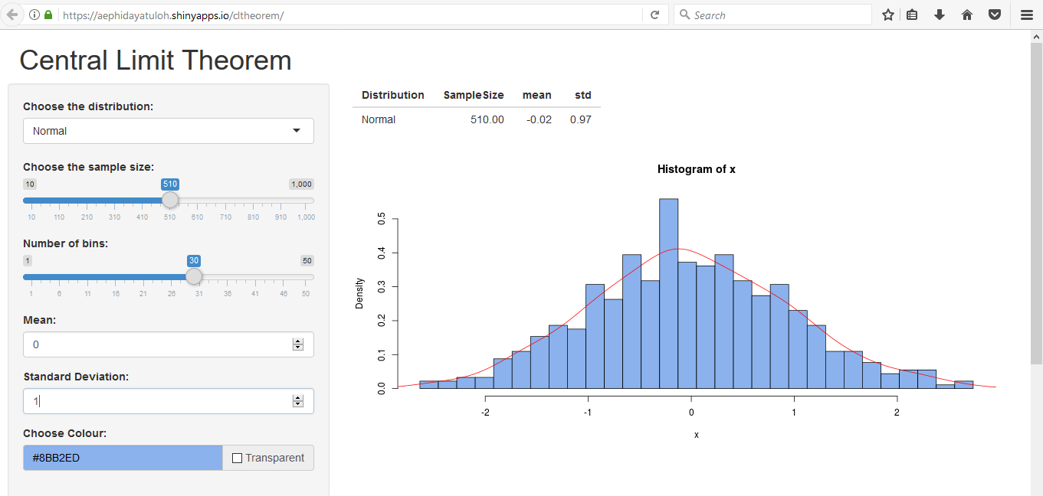
Access The Apps

Slide 25


